Slide 1
CSE322
Recursive and Recursively enumerable sets
Lecture #15

Slide 2
Definitions
A procedure for solving a problem is a finite sequence of instructions which can be mechanically carried out given any input.
An algorithm is a procedure that terminates after a finite number of steps for any input.

Slide 3
Definitions
A set X is recursive if we have an algorithm to determine whether a given element belongs to X or not.
A recursively enumerable set is a set X for which we have a procedure to determine whether a given element belongs to X or not.
A context sensitive language is recursive

Slide 4
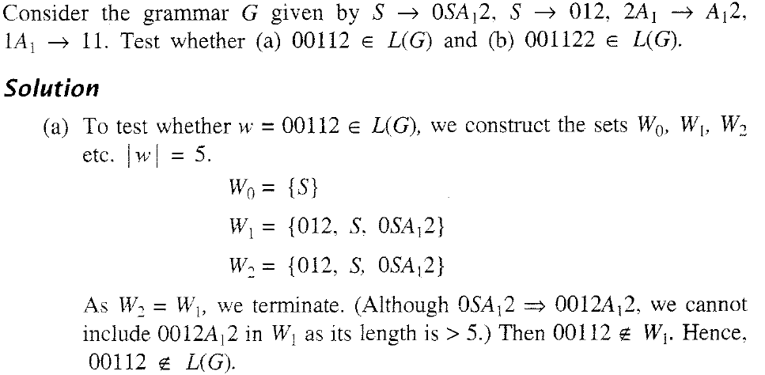
NUMERICAL

Slide 5
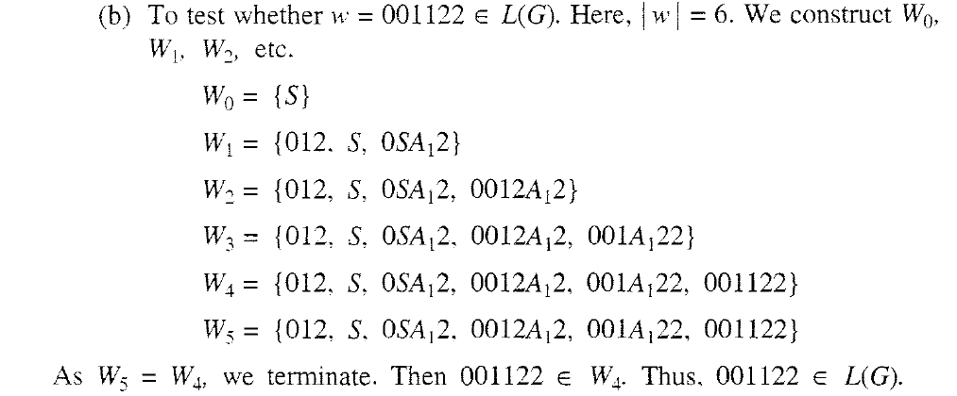
SOULTION

